Slide 1
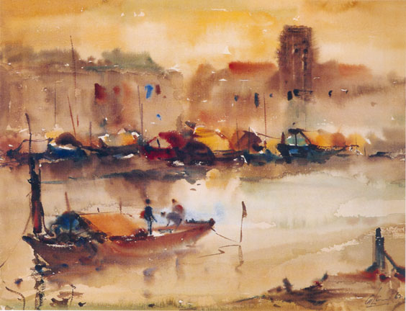
Lecture 6 (II):
Singapore’s business environment – case studies. c.1960s-80s.
Singapore River by Lim Cheng Hoe. c.1960s
Dr. Donna Brunero

Slide 2
How could Singapore develop its economy?
The ‘two-legged policy’
  The encouragement of Multinational Corporations (MNC) to invest in Singapore
  The creation of Government Linked Corporations (GLC)

Slide 3
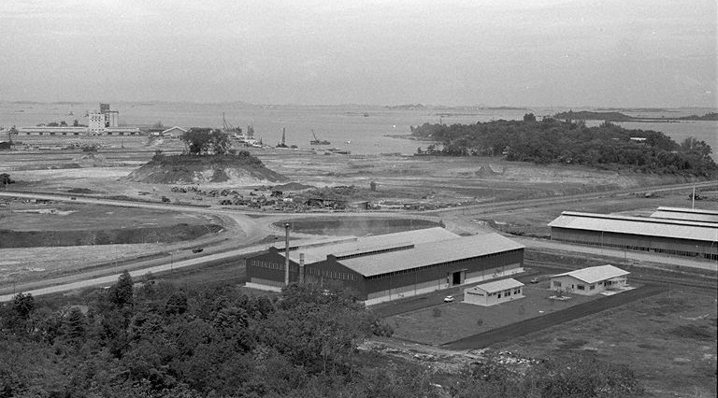
Jurong Industrial Estate 1966

Slide 4
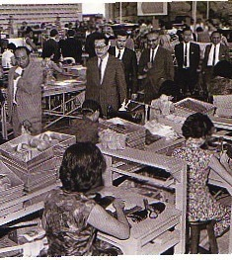
British Withdrawal
British withdrawal from airbases in 1971 rather than 1974 intensified the urgency for industrialization and job creation.
Bata Factory c.1970

Slide 5
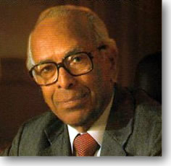
S. Rajaratnam, Feb 1972
Speech dealing with Singapore’s future as an Ecumenopolis, a‘world-embracing city’.
A city that operated on a global stage, not just regionally.
Technology and financial services as some of the key features of these ‘global cities’.

Slide 6
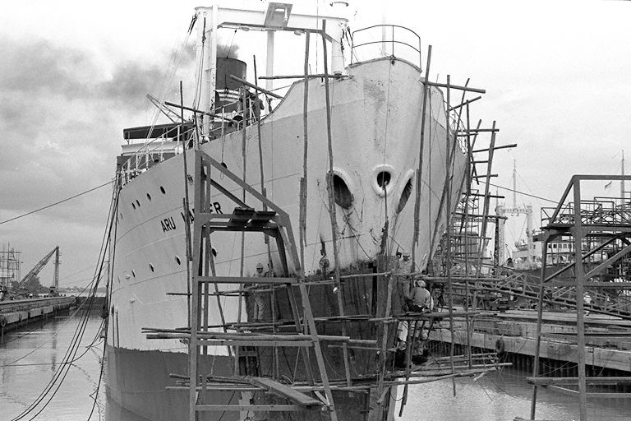
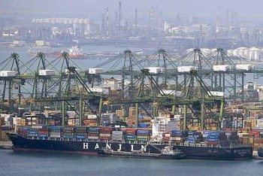
Further diversification: post 1970s.
Manufacturing
Financial services
Oil refining
Tourism

Slide 7
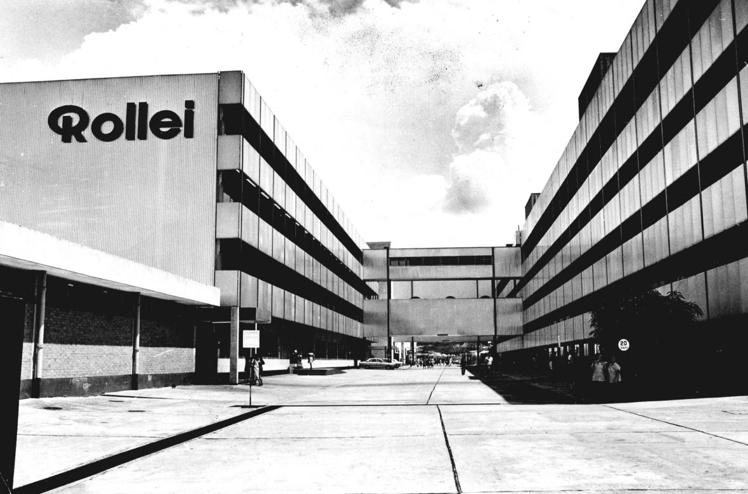
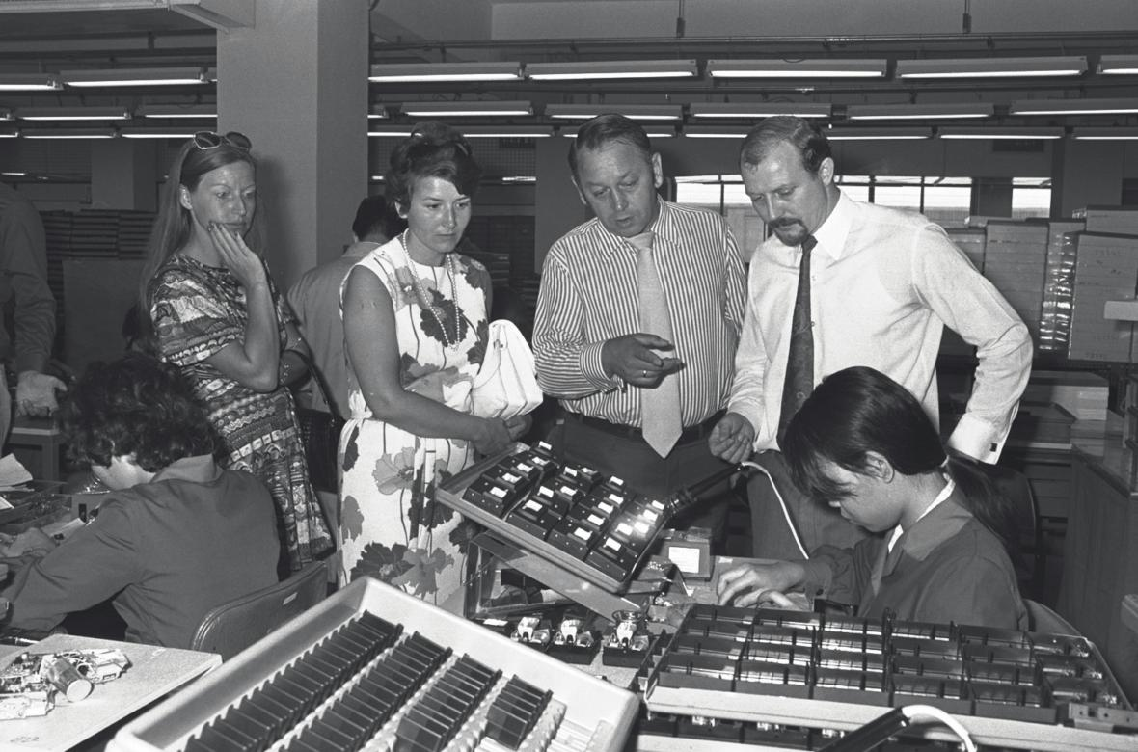
Rollei
A German company known for high quality cameras.
The EDB encourage Rollei to set up a factory in Singapore.
  Trained workers in precision manufacturing.

Slide 8
Where did small and medium businesses fit into the picture?
Did not fit into the government’s‘two-legged policy’
A general experience of alienation and indifference.
Crowded out, tough competition and higher labour costs.

Slide 9
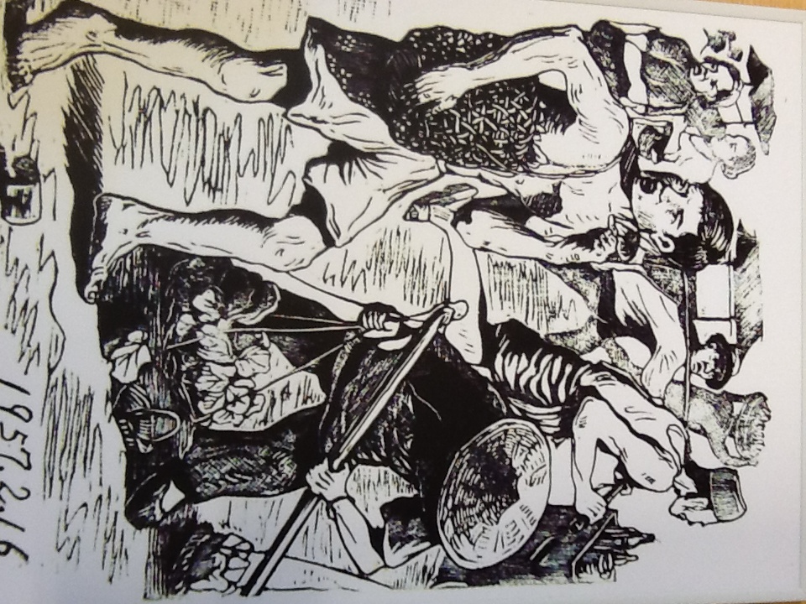
Perceptions of ‘traditional’ Businesses
Traditional trades were marginalized under the rhetoric of improvement.
Not seen to have a major role in Singapore’s economic transformation’
Familism, nepotism ran counter to meritocracy.
“Illegal Hawkers” reproduced from the NUS Museum’s collection.

Slide 10
Example: Pawnbrokers
Origins in the mid-1800s, ‘revenue farming’.
Drew on networks, dialect ties, Hakkas as the dominant group.
Family run and operated.
‘Pawnbrokers Association’ as a representative body.
By 1960-70s: series of government regulations to curb pawn broking in preference to formal banking.

Slide 11

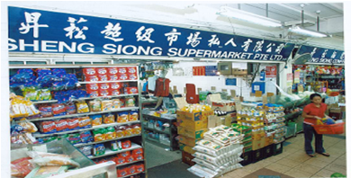

Case Studies:
Shen Siong and Qian Hu Corporation…
Reclamation of land for housing and redevelopment led to the loss of farmlands.
Farmers (pig farmers) had to find alternative sources of business…

Slide 12
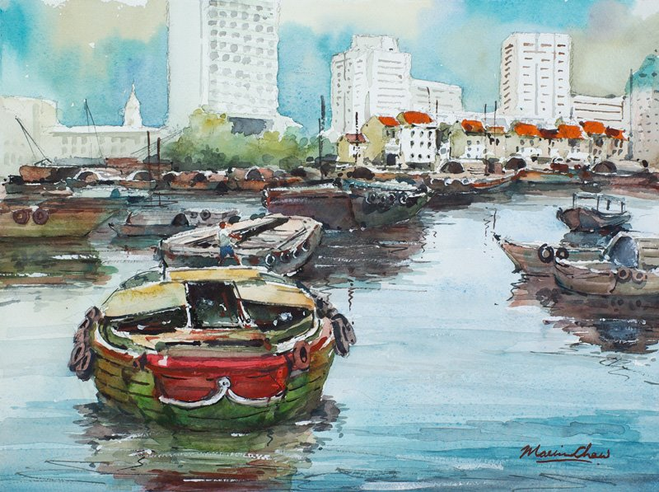
Fate of the Singapore River?

Slide 13
Changing Policy, 1989
Government willing to see more ‘traditional’ businesses (Small and Medium sized Enterprises SME) have a role in economic development
From two-legged to a three-legged policy.

Slide 14
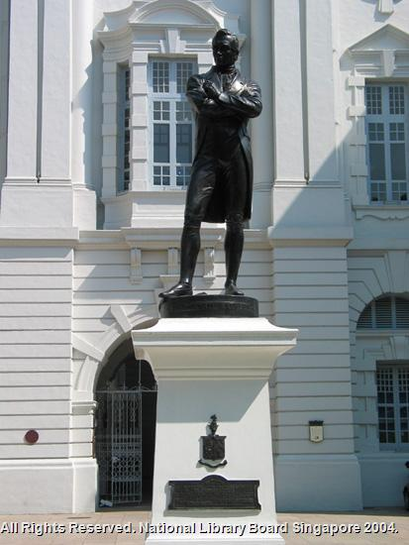
Challenges and opportunities for Businesses
‘Business as usual’?
Increased competition from MNCs and GLCs
Increased exposure to international forces
Need to take on a more ‘global’ branding and outlook?

Slide 15
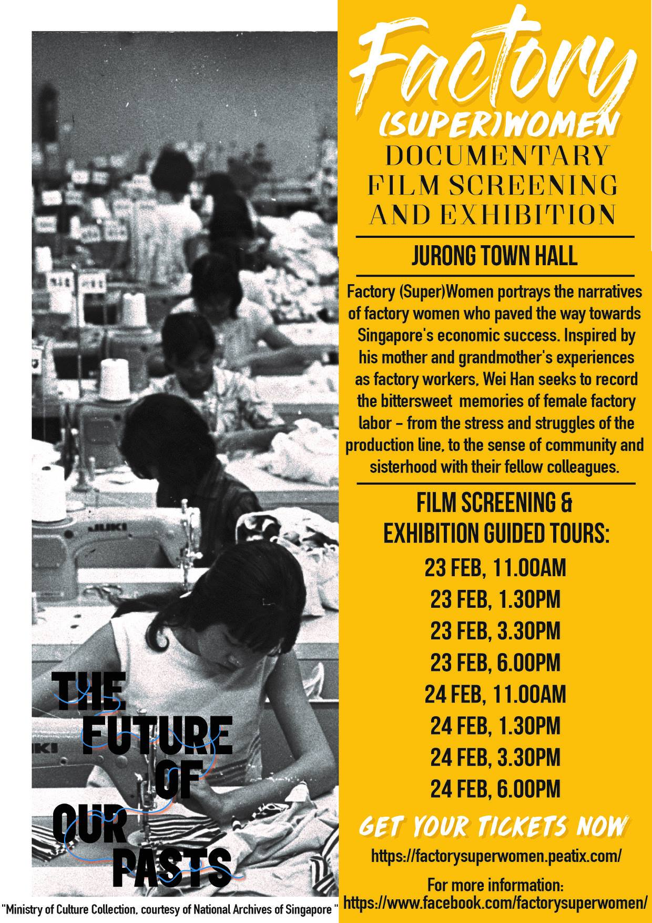
For your interest:
“Have Any Stories on Singapore’s Industrial heritage to share?”
https://www.straitstimes.com/singapore/have-any-stories-on-singapores-industrial-heritage-to-share

